Slide 1

Duolingo
VICTOR MANUEL GALVAN COVARRUBIAS | TI 2-4
Oral presentation
English II
Teacher Cinthya Rivera Diaz

Slide 2

Background
Luis von Ahn, CEO
Also the inventor of CAPTCHAs, and a MacArthur Fellow. He has sold two companies to Google and given popular TED talks.
Launched Duolingo in 2012 along with co-founder Severin Hacker.
Its success is down to a combination of clever, intuitive design aspects and constantly evolving teaching methods.
"What I wanted to do was create a way to learn languages for free.“

Slide 3
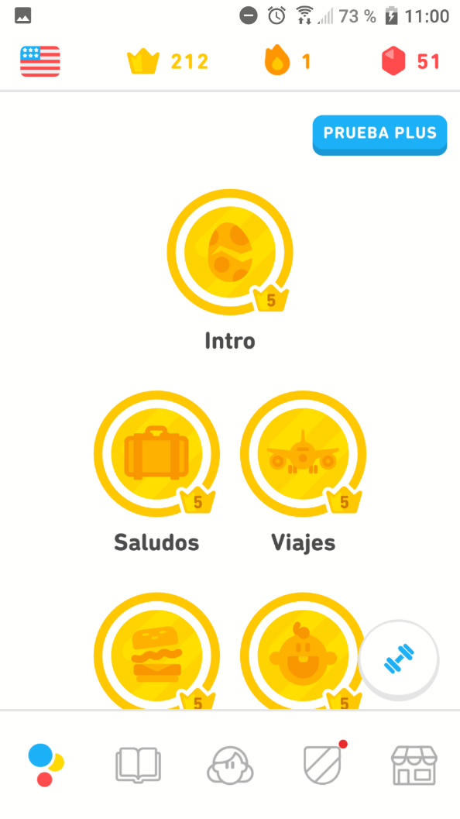
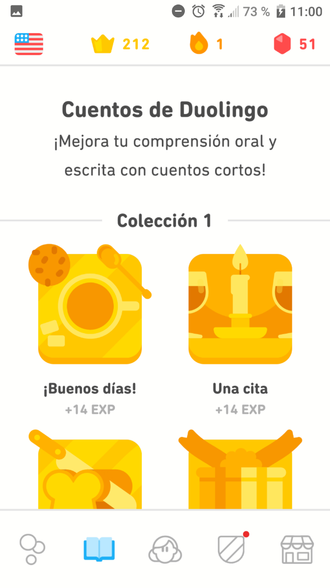
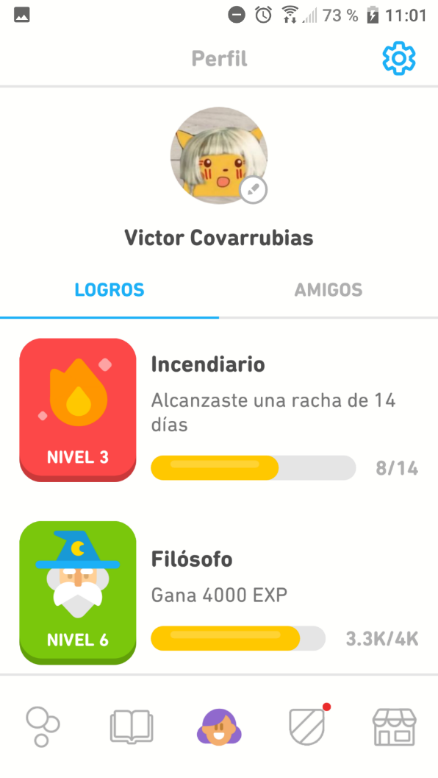
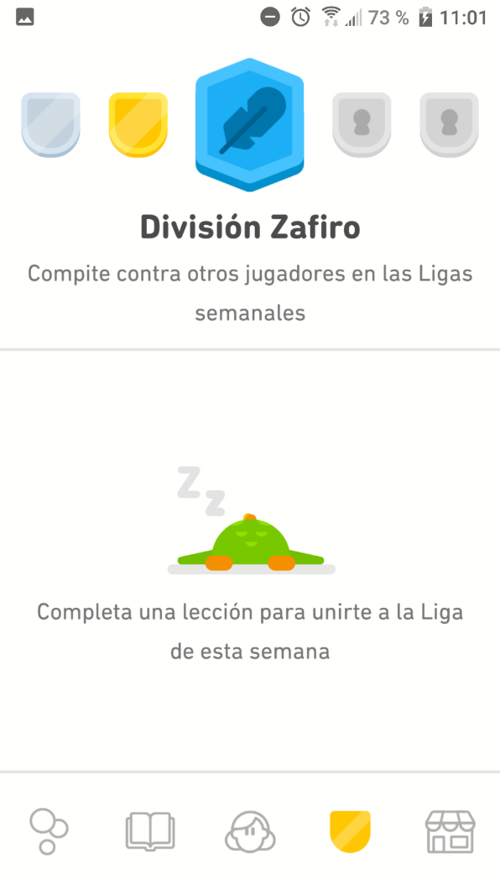
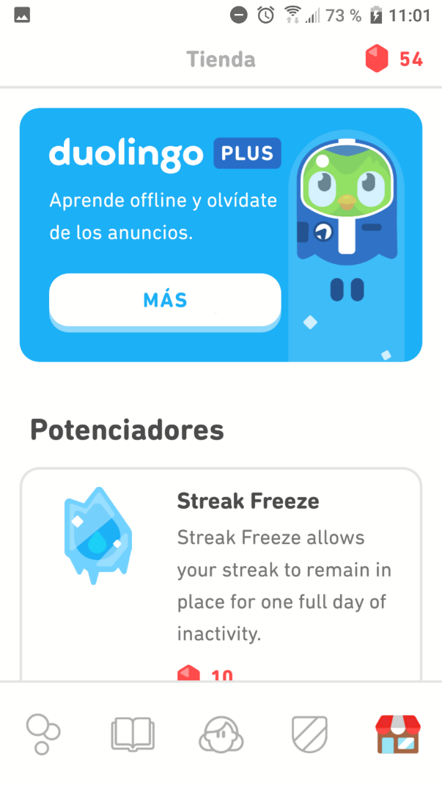
Use of the app

Slide 4
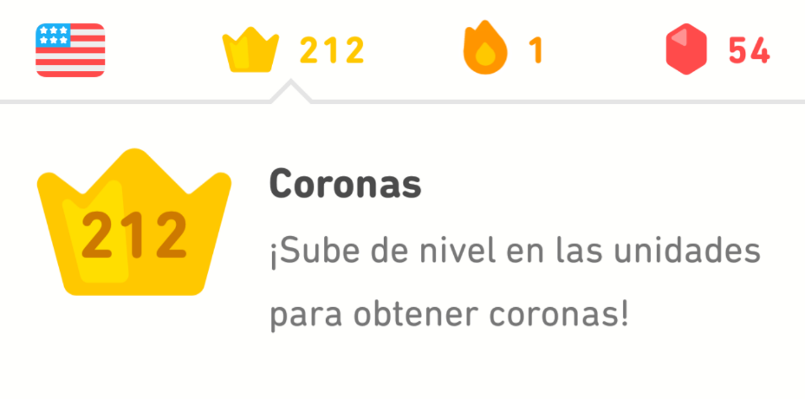
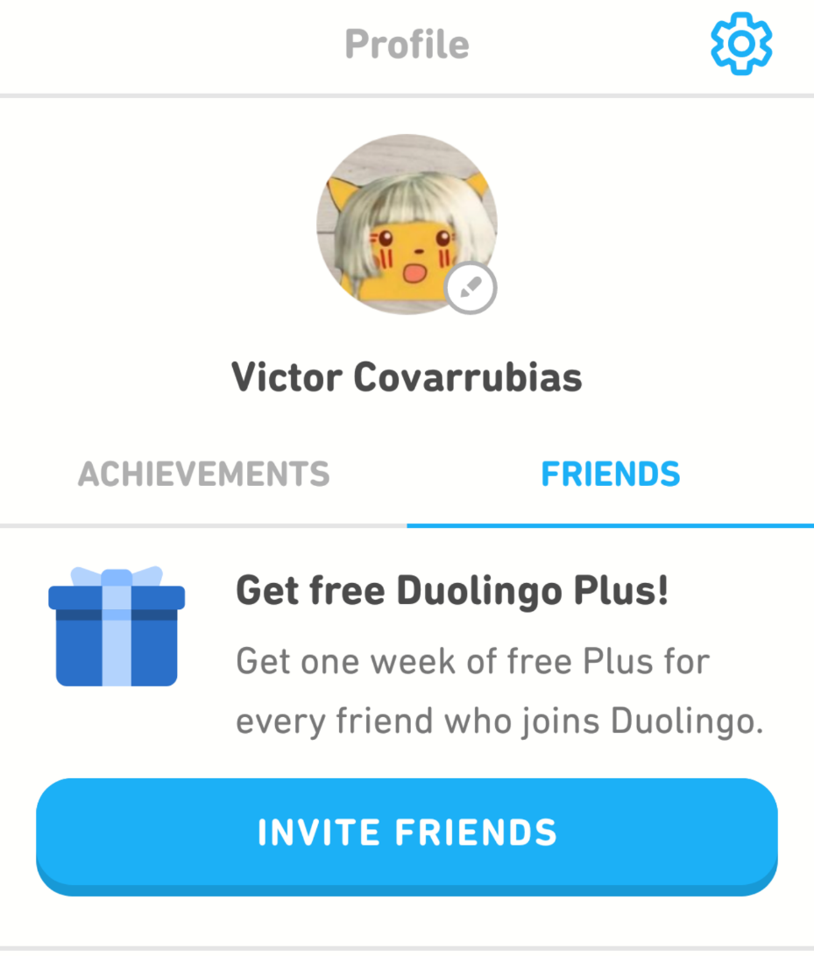
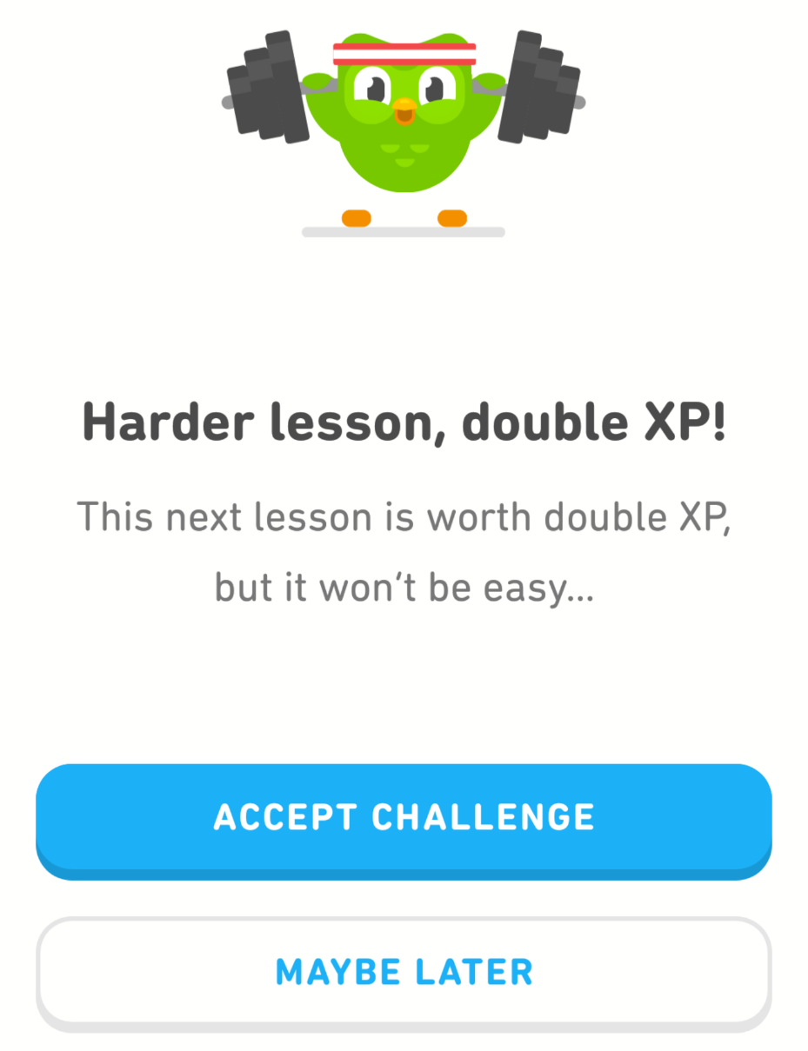
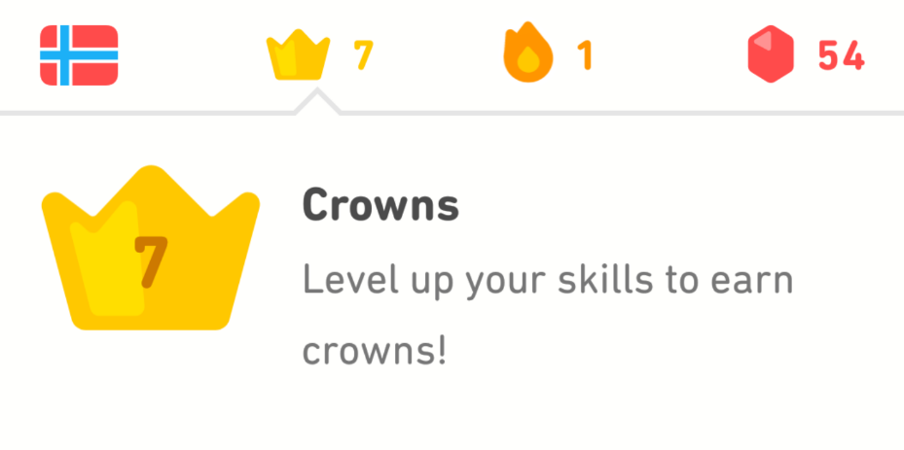
Crowns, challenges and Friends

Slide 5
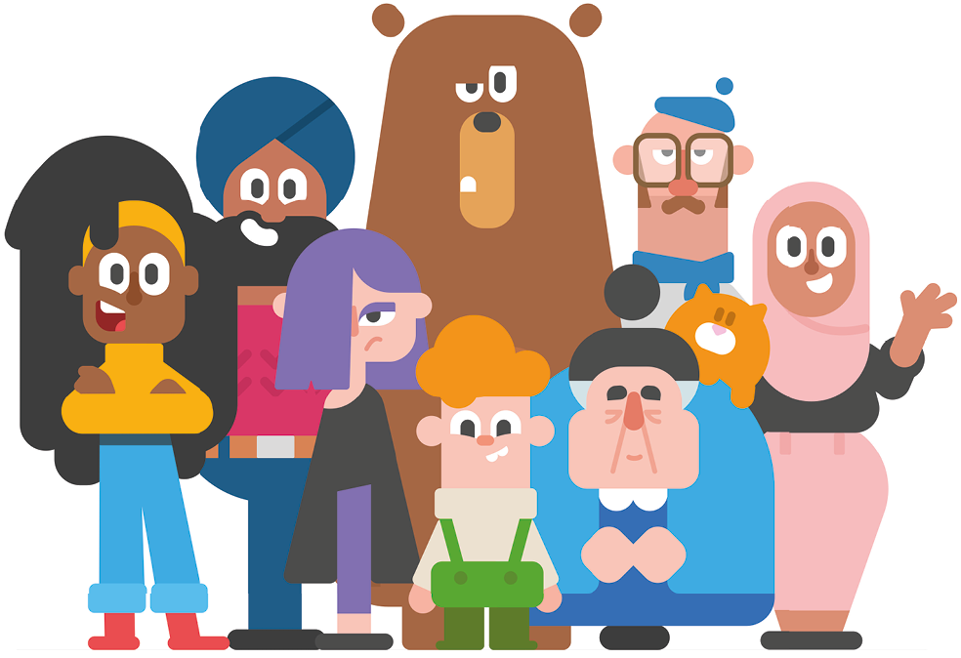
Impact on society
Language means culture. Not simply means communication, but also as a means of showing pride and solidarity in one's culture.
Even if Duolingo makes language learning a lot easier, there are all sorts of factors that keep languages just as plentiful and diverse.

Slide 6
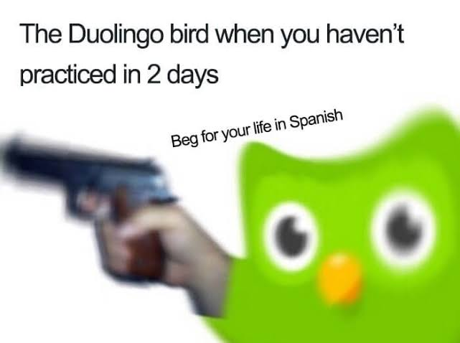

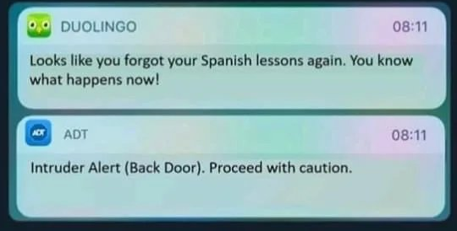
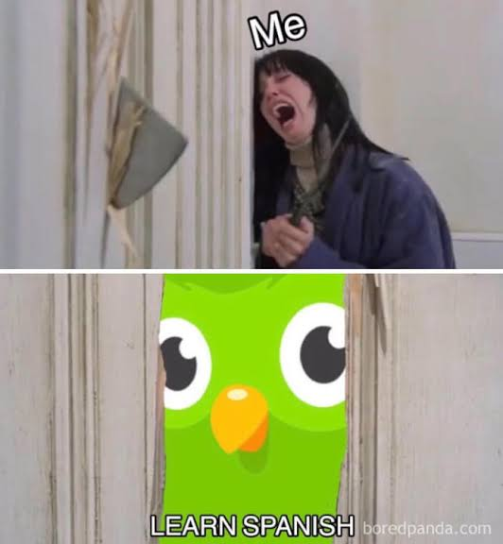
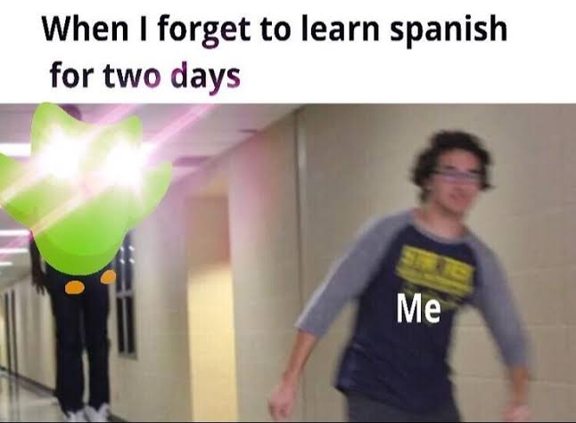
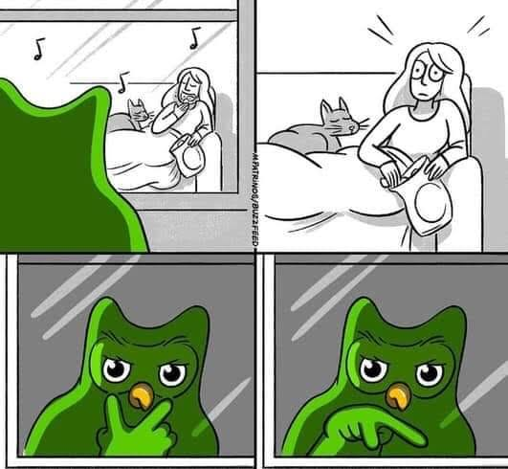
Oh yeah! There are memes!
April 2019

Slide 7
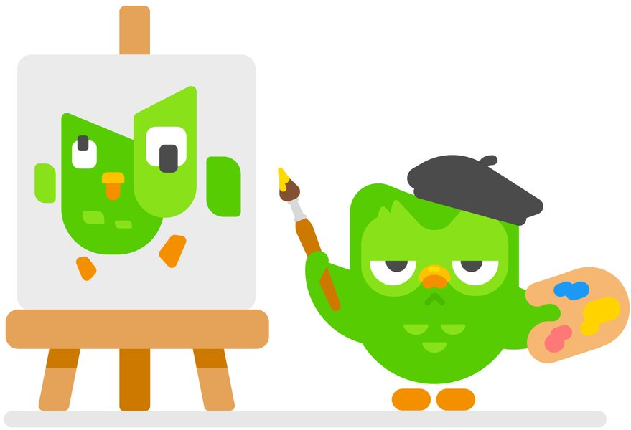
Fun facts
There are over 300 MILLION users on Duolingo!
Duolingo is valued at over $700 million USD.
Duolingo is the most popular language-learning website in the world.
BY FAR!!

Slide 8
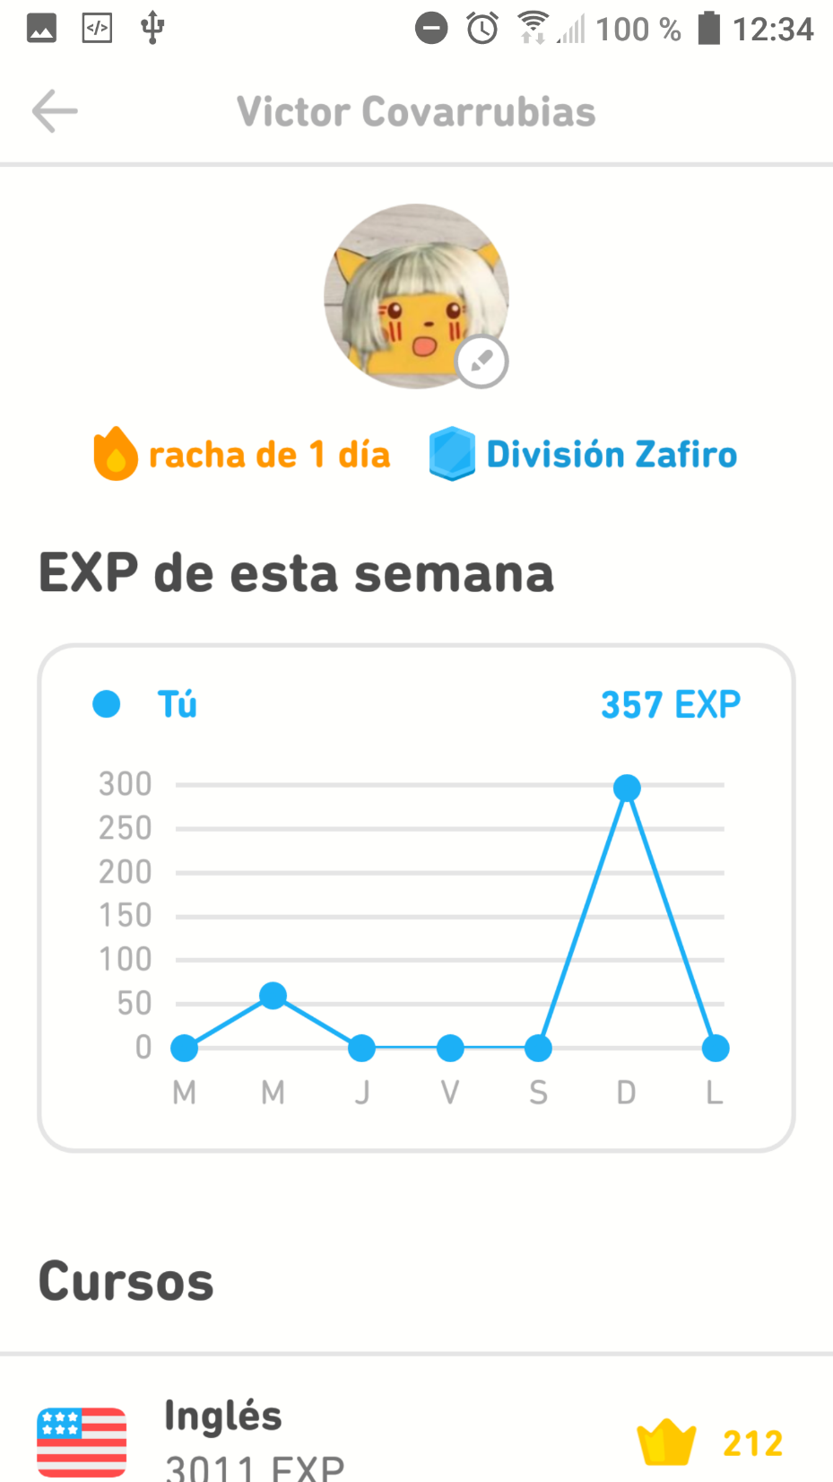
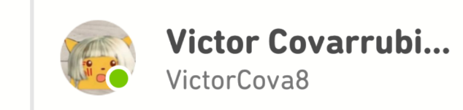

Slide 9
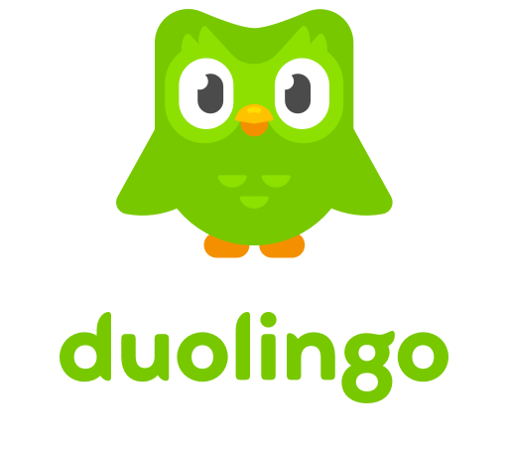


https://youtu.be/dEjdNUDsbE8
Thanks for watching!
Evidence that I was dressed for the presentation.

